Slide 1
Universität für Bodenkultur Wien University of Natural Resources and Life Sciences, Vienna Andre Hackelberg Exchange Coordinator Incoming Student Support

Slide 2
International Students at BOKU
International students at BOKU 2017: 22% (13.000 Students total)
ZIB is -among others- in charge of exchange students and students of international master programmes
About 400 exchange students per year
500 students in international Master programmes

Slide 3
Actors
Best Support
ZIB
Erasmus Student Network
Austrian Student Union
Departmental Coordinators/Study Services

Slide 4
Administration
Students
Science

Slide 5
Exchange Programs
ERASMUS
CEEPUS
Joint Study
Others

Slide 6
Homepage

Slide 7
Welcome Days

Slide 9
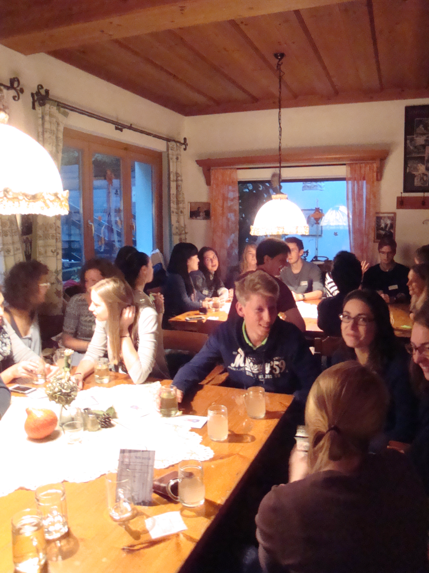
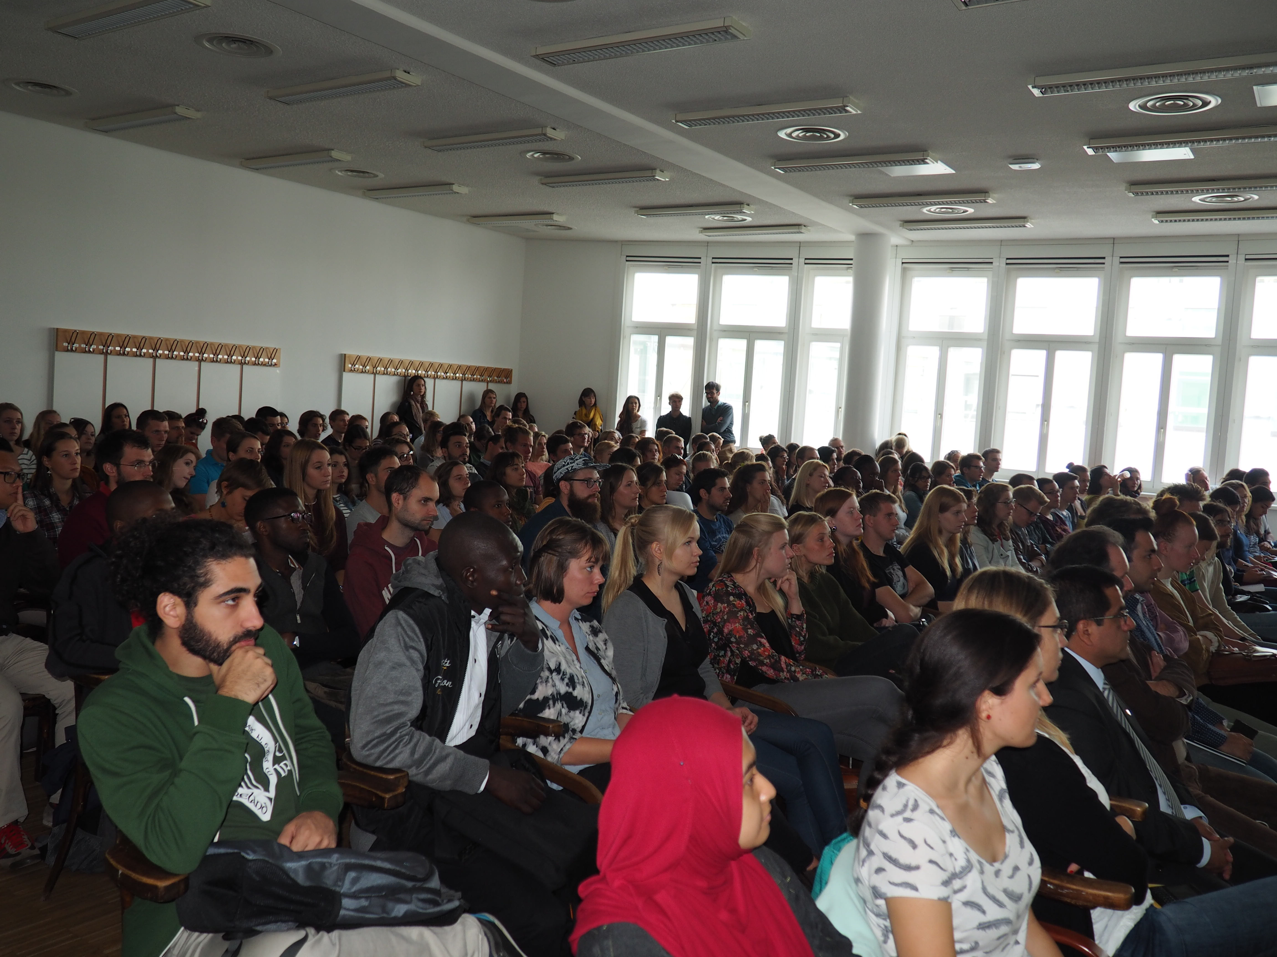
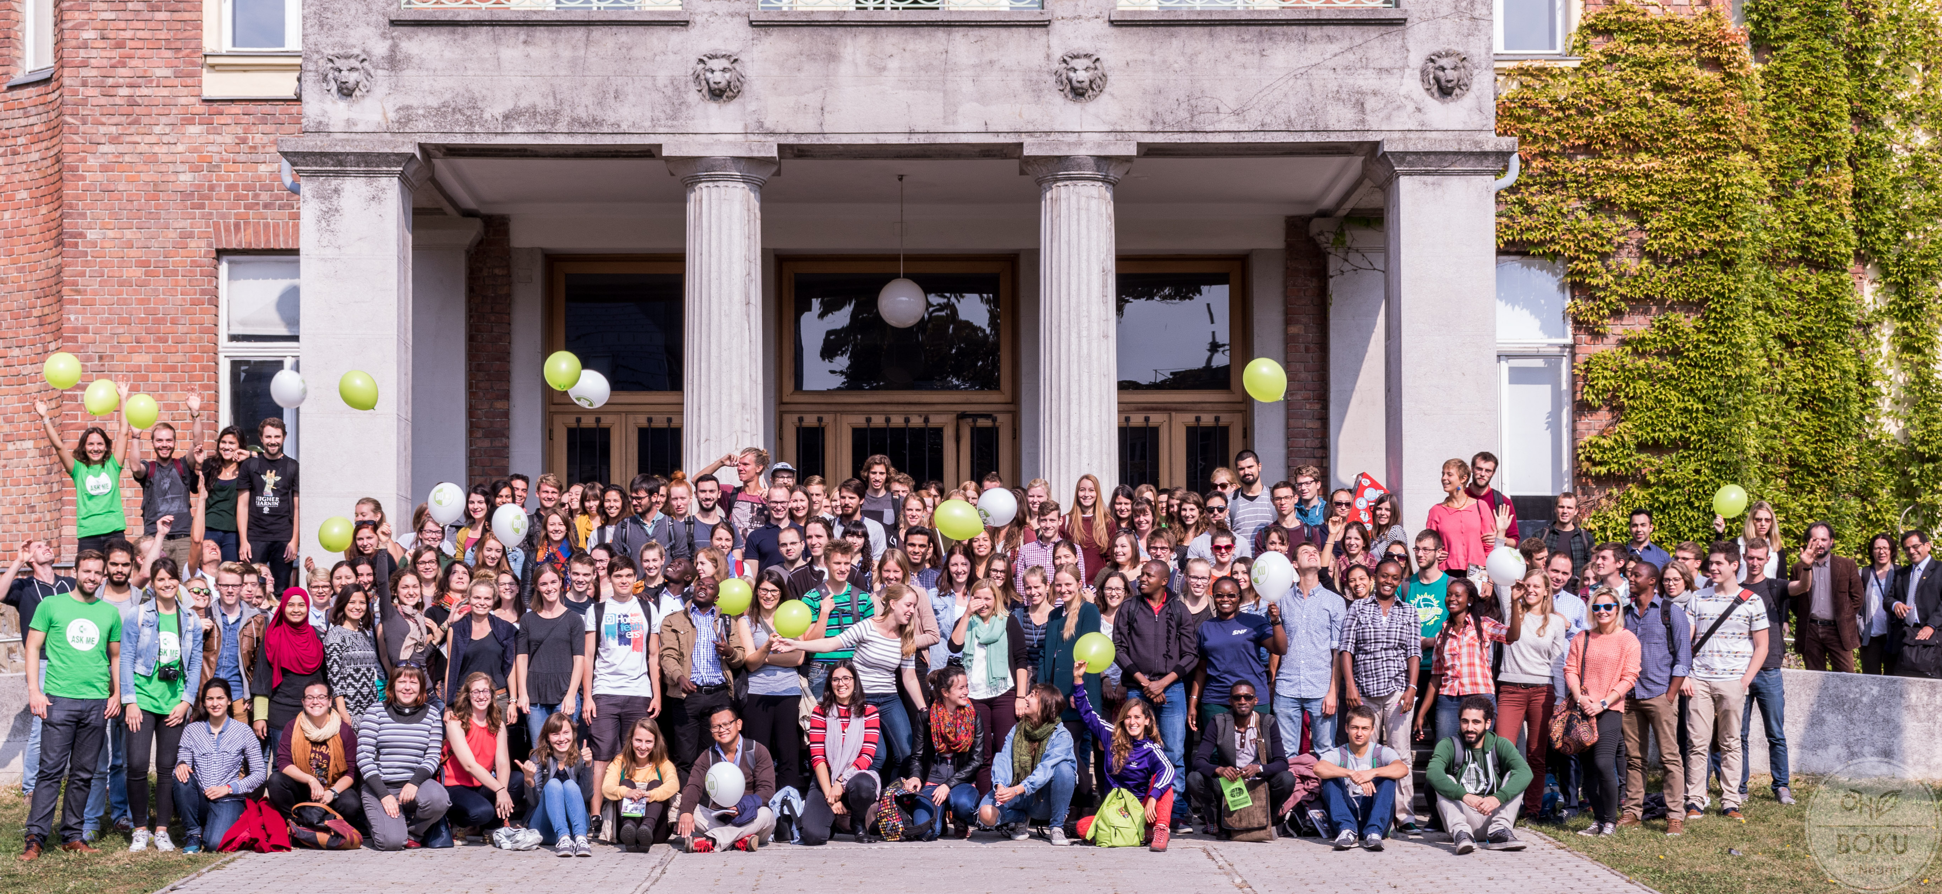
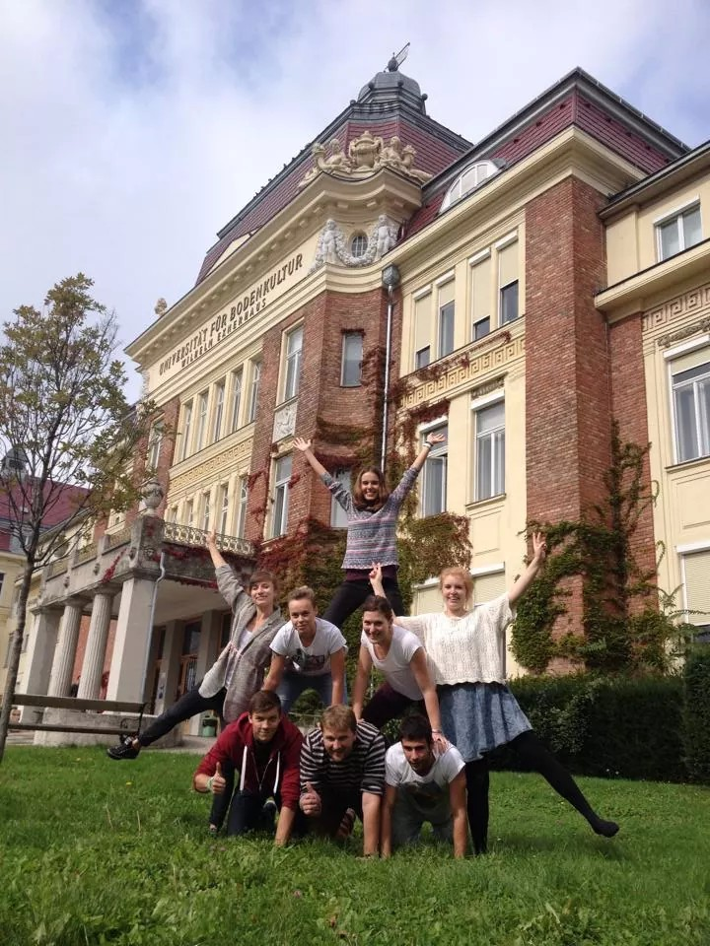
Impressions of our Welcome Days

Slide 10
Practical Issues – Housing/Visa
Organised by the housing office of the Austrian Exchange Service – OeAD: http://housing.oead.at/
Student dormitories all over Vienna
Different price categories
Deposit needed
Application on time
ZIB only helps to find student accommodation in case of emergency
gives advise in Visa applications

Slide 11
Buddy Network at BOKU
Aim: Exchange of Austrian and international students
International students are appointed an Austrian student as a tutor
How does it work?
E-Mail contact in advance
Pick up from train station or airport (if possible)
Support with the first steps at BOKU and in Vienna
Introduction to Viennese university life

Slide 12
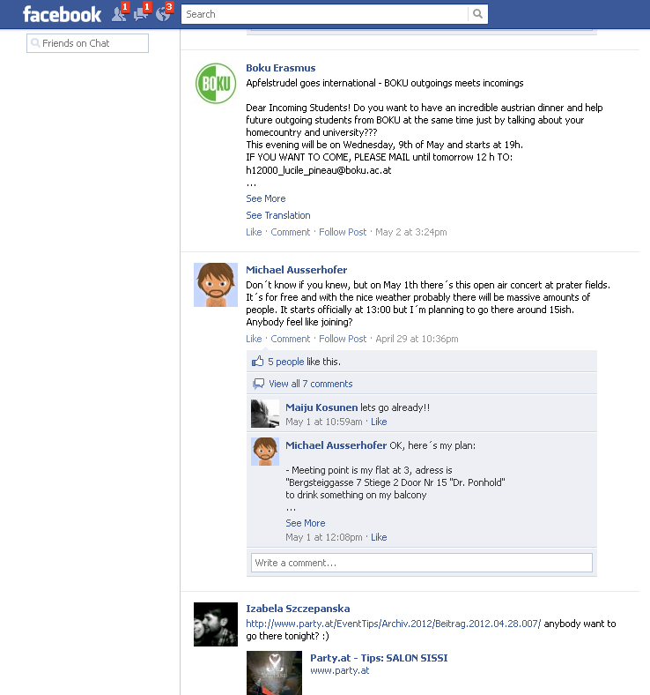
Student Exchange on Facebook
Different groups:
Incoming BOKU (also for buddies)
Outgoing BOKU
Accommodation Exchange BOKU
Language Courses

Slide 13
Tandem-Learning
Students with different native language teach each other:
You want to improve your German – You offer your native language.
Students decide with their partner, when, where and how they would like to learn.
Free of charge
Introductory Kickoff-Meeting
Certificate (according to Tandem-Diary)

Slide 14
Youtube Channel

Slide 15
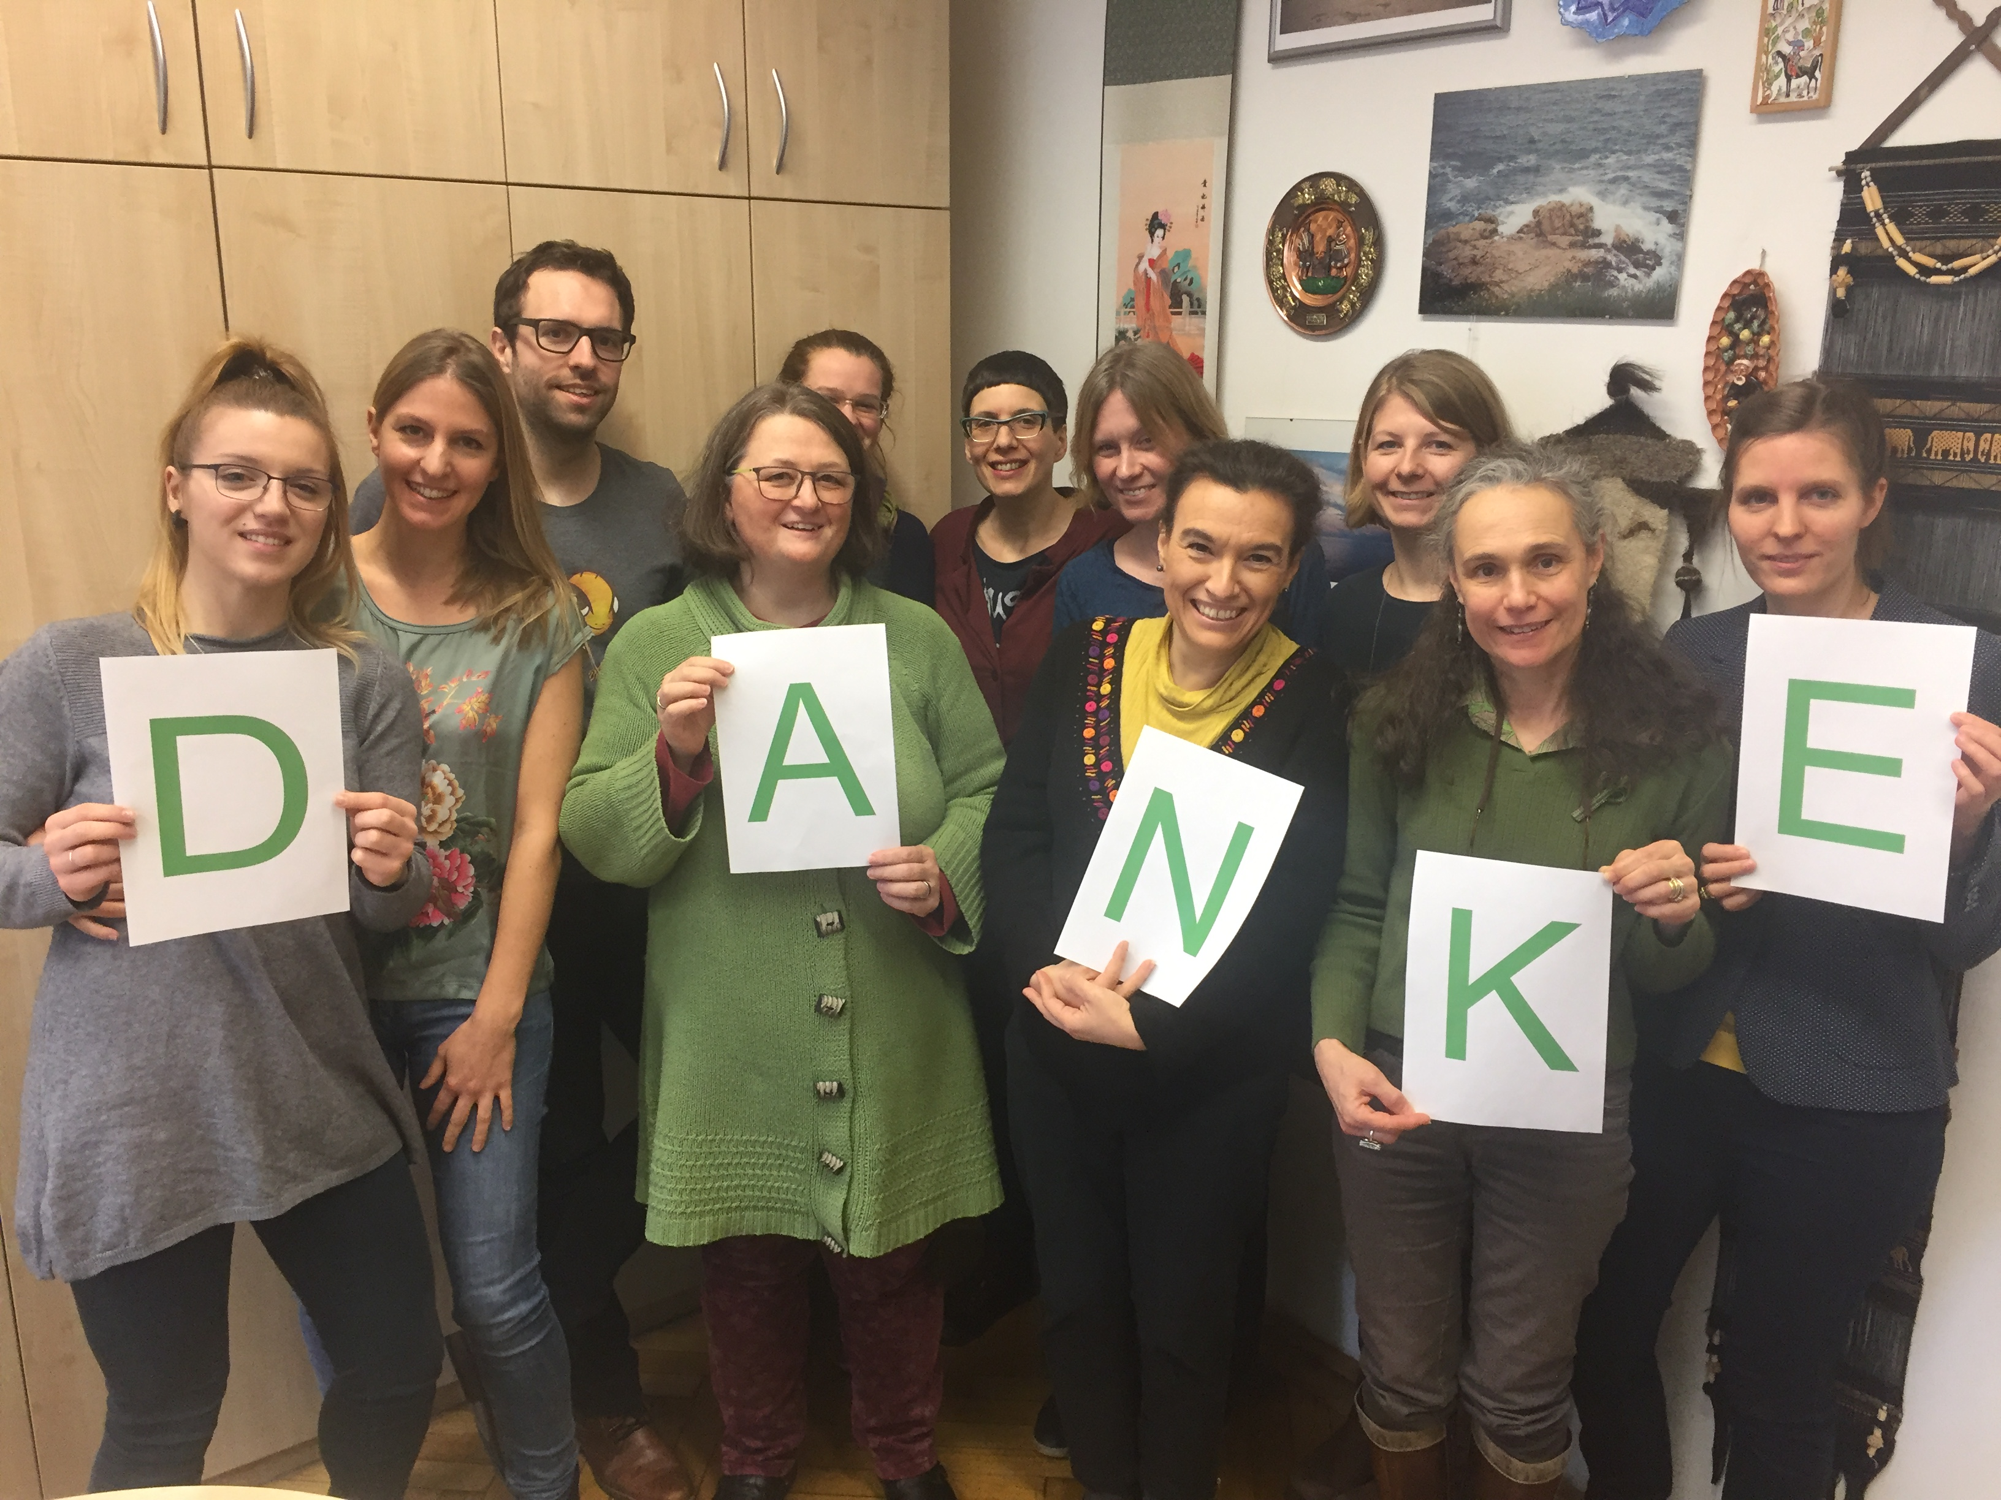
Thank you for your attention
E-Mail: andre.hackelberg@boku.ac.at

